Slide 2
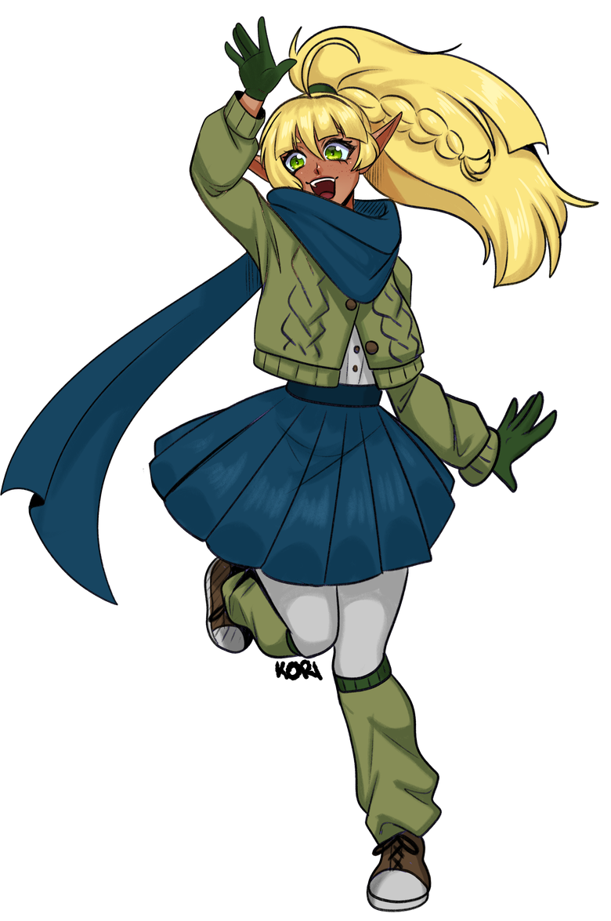
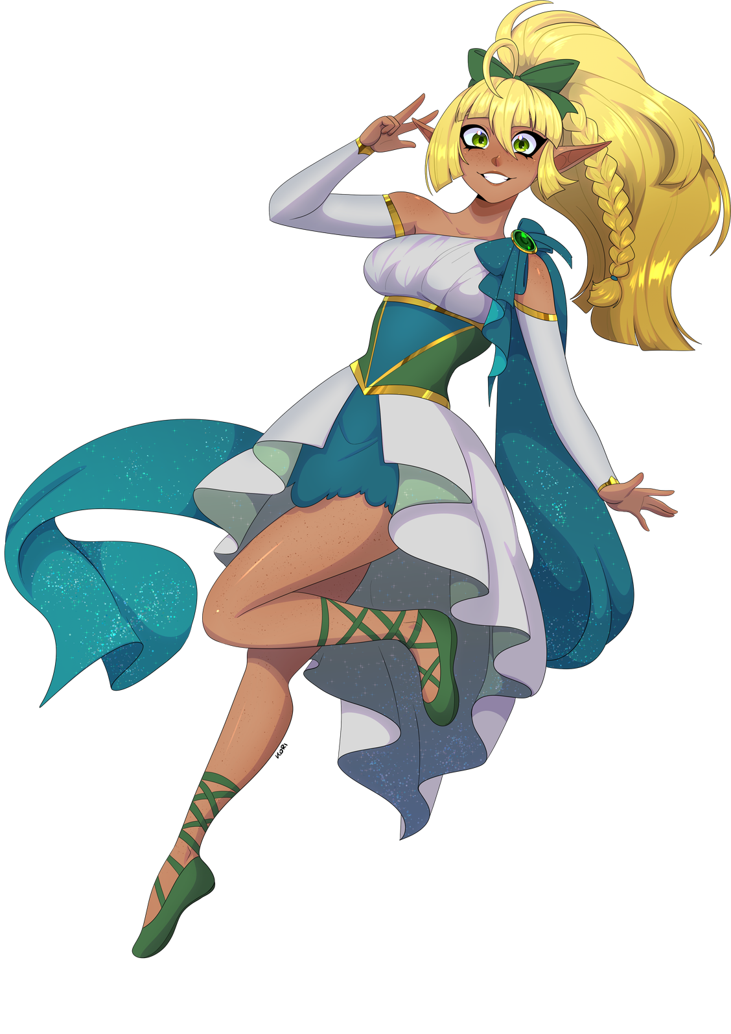
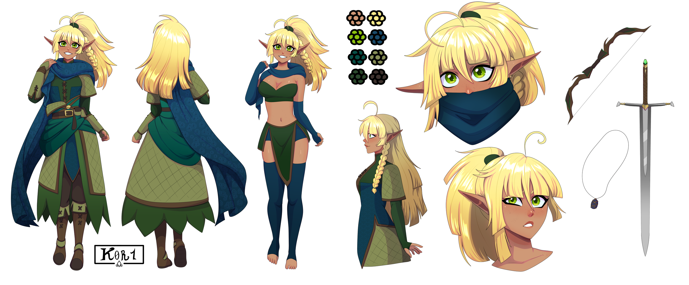
ANIME → TTRPGS
The Storytelling Pipeline
TORACON 2026

Slide 3
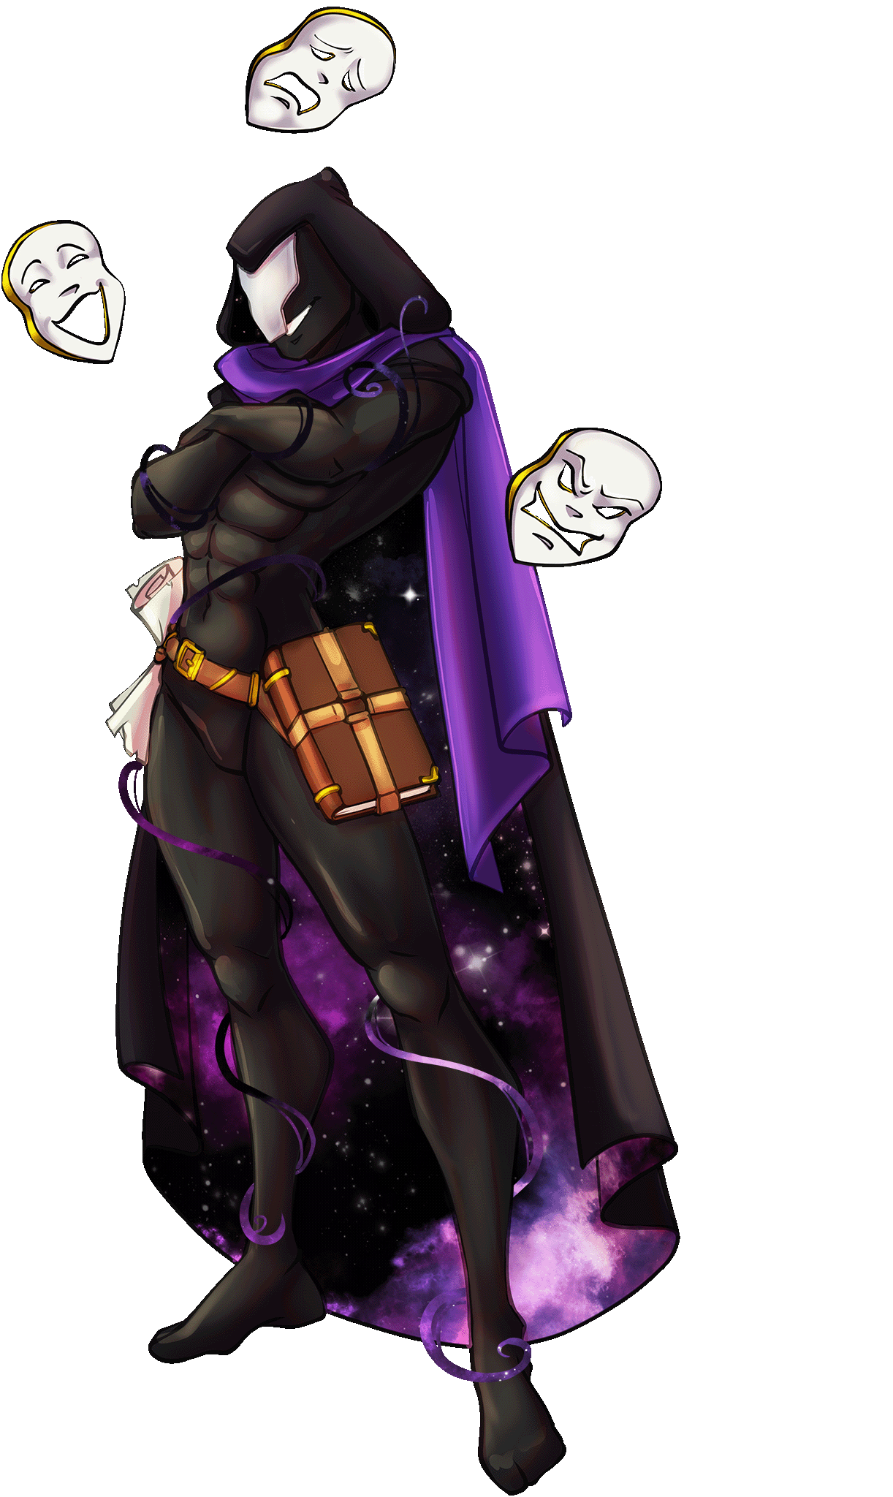
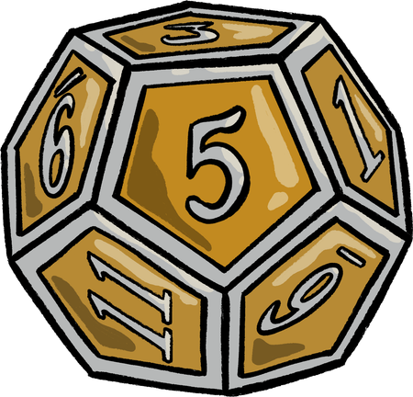
Overview
This panel explores how anime and tabletop role-playing games connect through a shared focus on storytelling.
Anime introduces audiences to compelling characters, rich worlds, and ongoing narratives, while tabletop games build on that by letting people step into those roles and shape the story together.

Slide 4
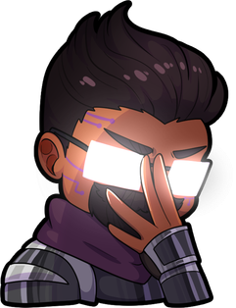
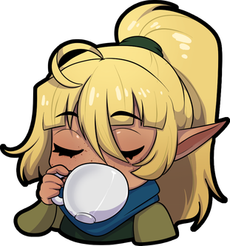
Key Points 1st Season
1
Narrartive Structure
3
Worldbuilding
Anime builds an intuitive understanding of how stories flow and evolve
It sparks curiosity about how worlds function beneath the surface.
2
Characters
4
RPG Pacing
It encourages people to think deeply about who their characters are.
Many series follow a structure that naturally mirrors gameplay progression.

Slide 5
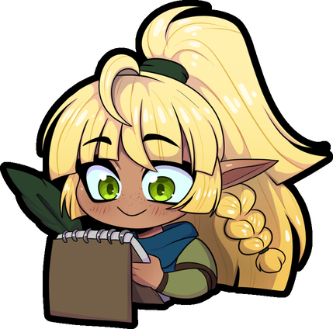
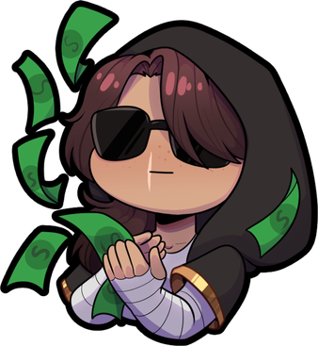
Key Points 2nd Season
5
Creative Output
7
TTRPG Design
It motivates fans to create and expand on the stories they love.
Its style and themes continue to shape how modern games feel and play.
6
Storytelling
8
In Closing
It highlights the shift from observing a story to actively shaping one.
The connection is a natural pathway from inspiration to participation.

Slide 6
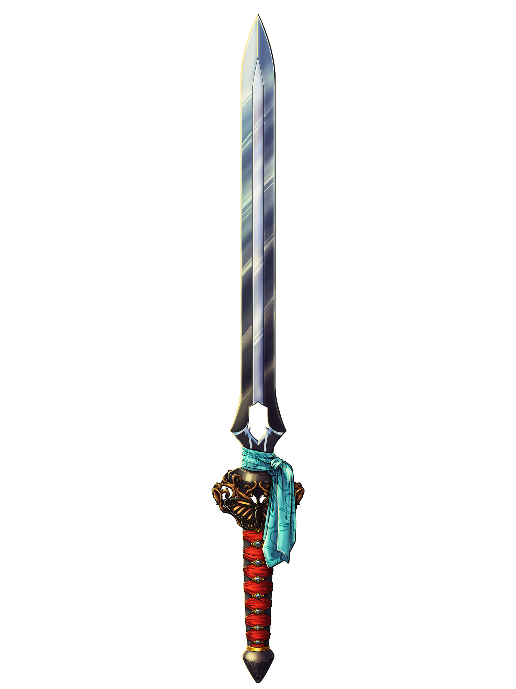
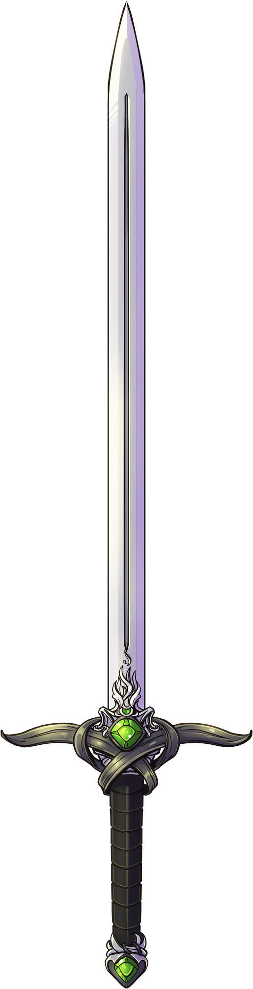
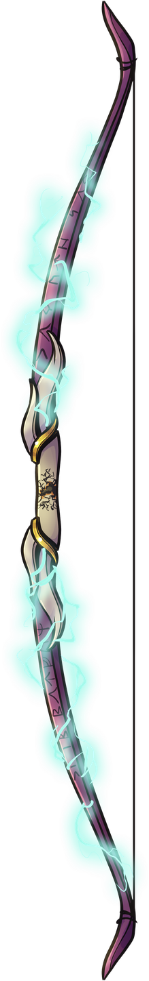
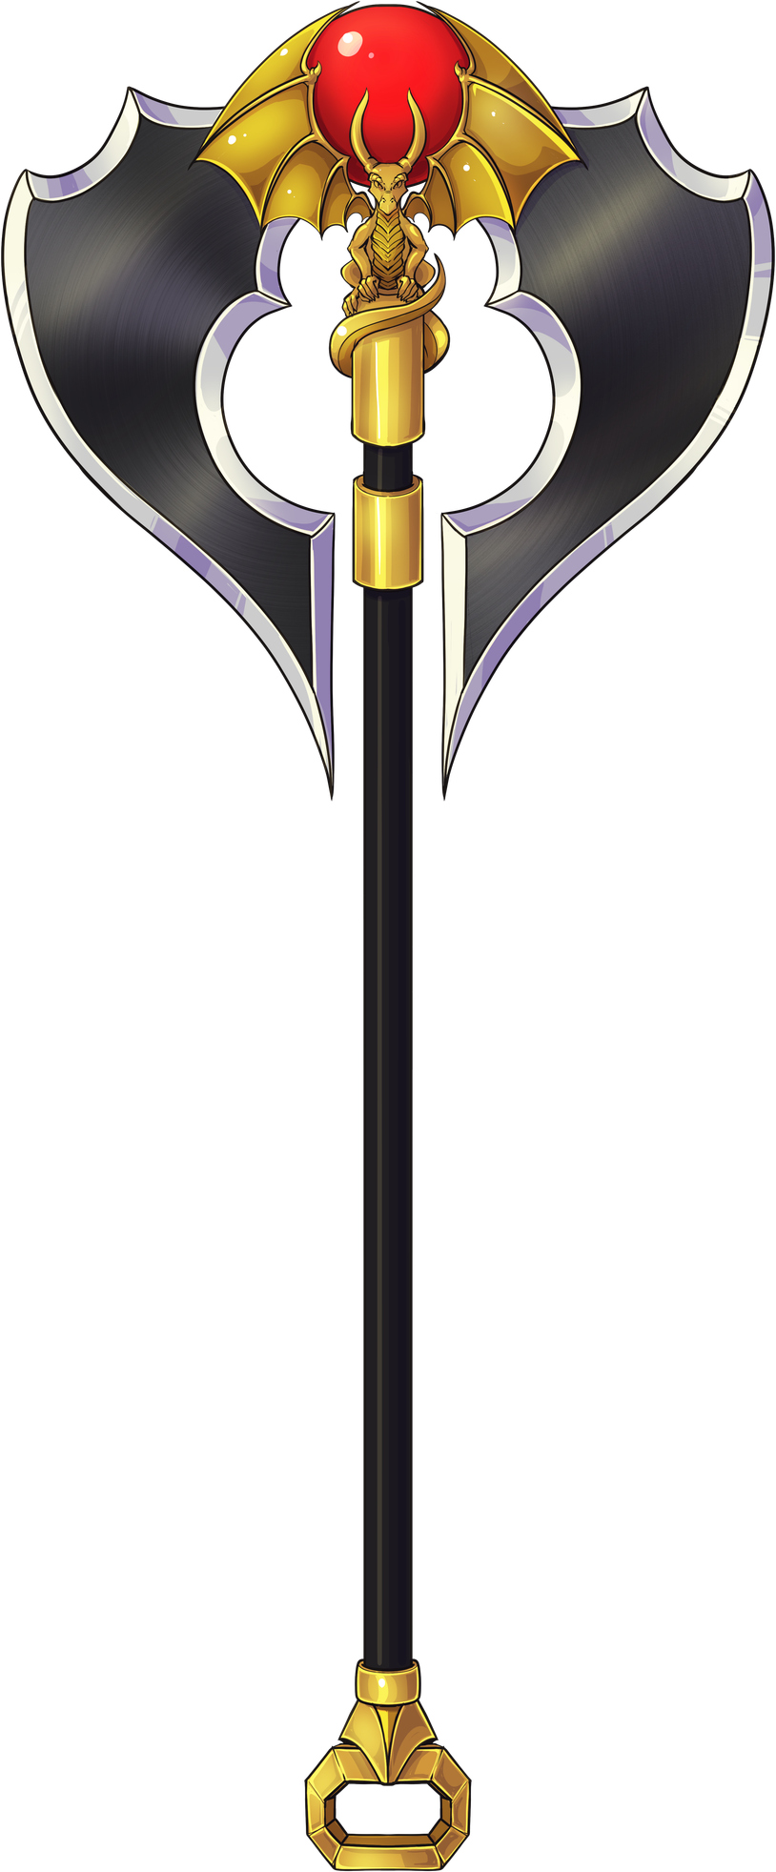

Imagine...
...your favorite anime character or series.
Stepping into their world, making choices,
and shaping the story yourself.
That’s the pipeline. From an inspiration
to a spark of creativity.
TTRPGs are that outlet for more...

Slide 7
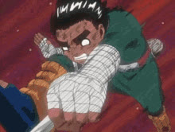
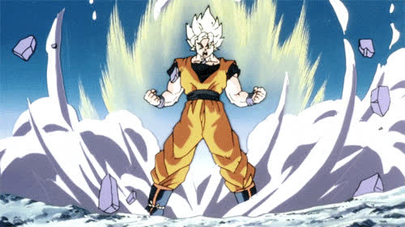
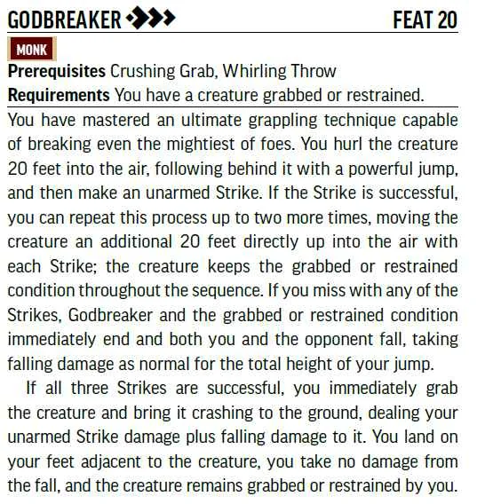
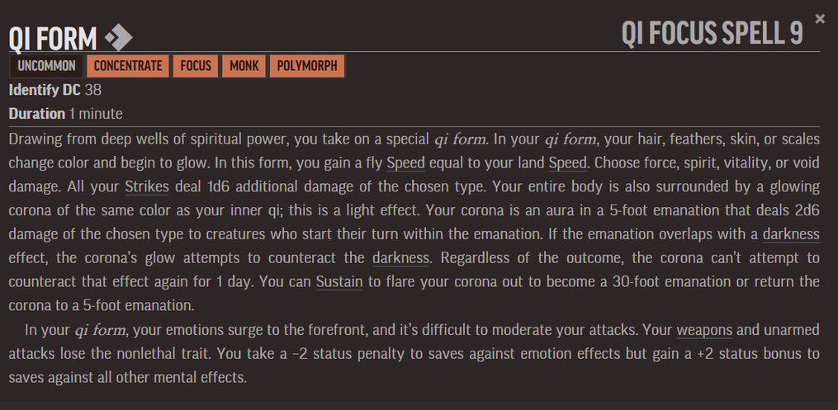

Slide 8
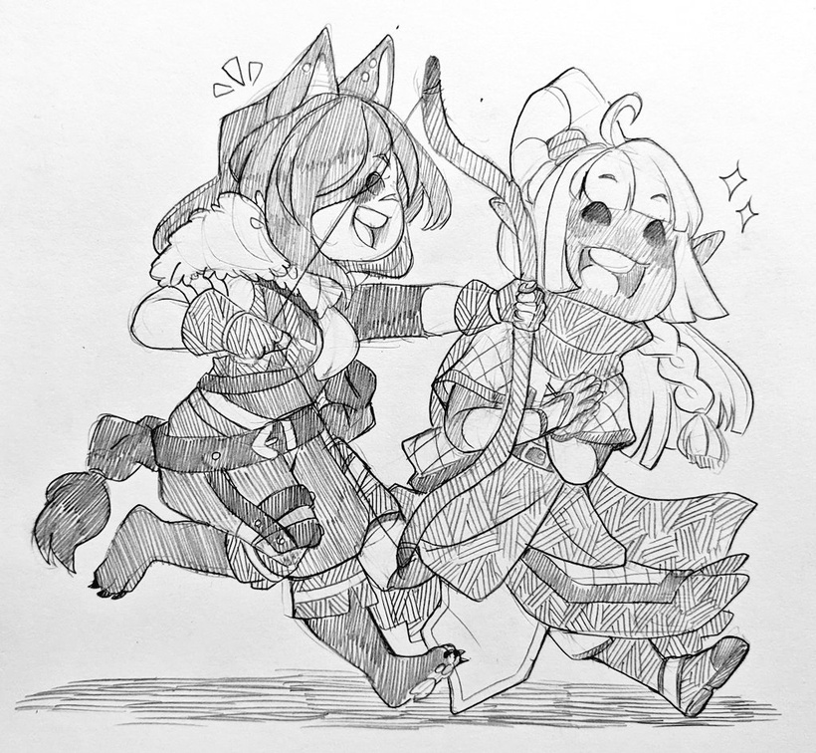
Anime Teaches the Language of Story
Anime introduces audiences to narrative structure in a very accessible way.
Common anime story elements map almost perfectly to TTRPG play:
Anime Element
Protaganist
Party/Friend Group
Story Arcs
Villians
Power Growth
Training Episodes
Boss Fights
TTRPG Element
Player Character
Adventuring party
Campaign Arcs
Antagonists/Bosses
Leveling up
Downtime/Skill Growth
Major Encounters

Slide 9
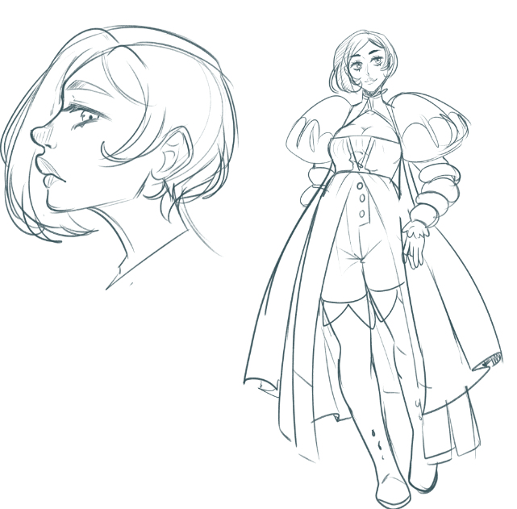
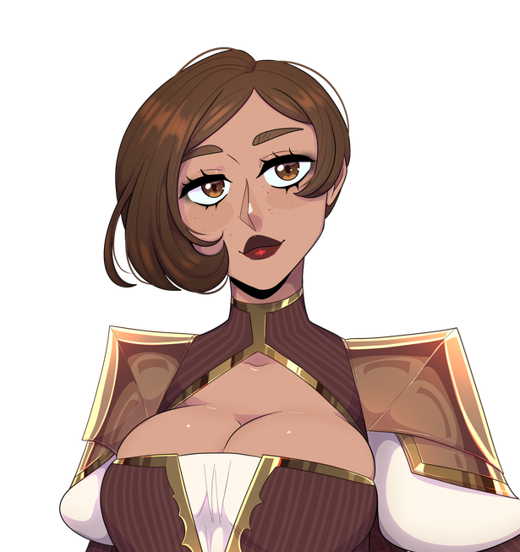
Anime Inspires
Character Creation
Anime fans are used to thinking about characters in deep ways.
This mindset translates directly to TTRPG character creation.
Signature abilities
Backstories
Personal motivations
Character growth arcs
Dramatic rivalries
Anime: “What would my power be?”
TTRPG: “What class would my character be?”

Slide 10
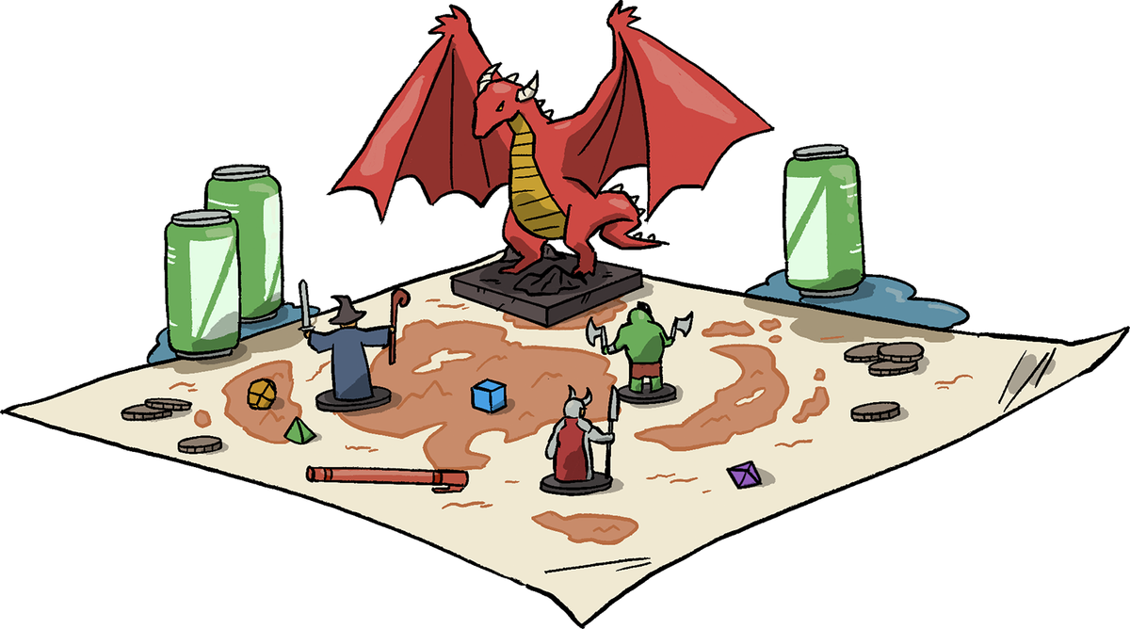
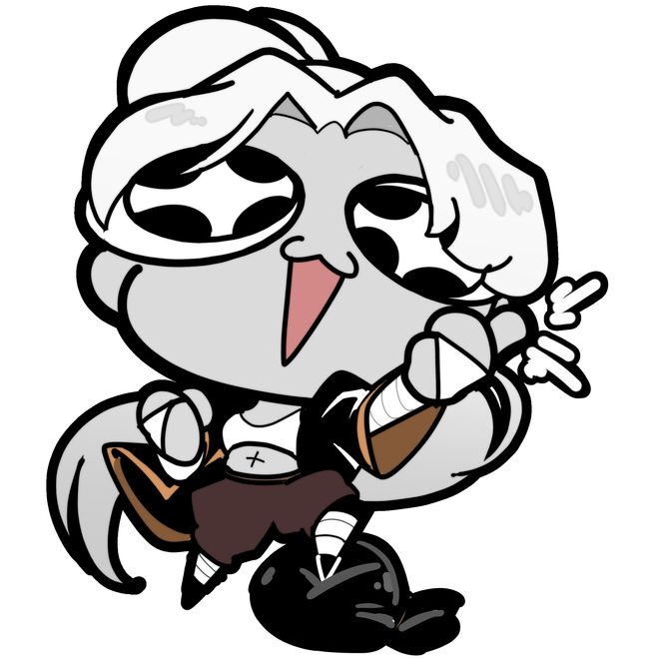
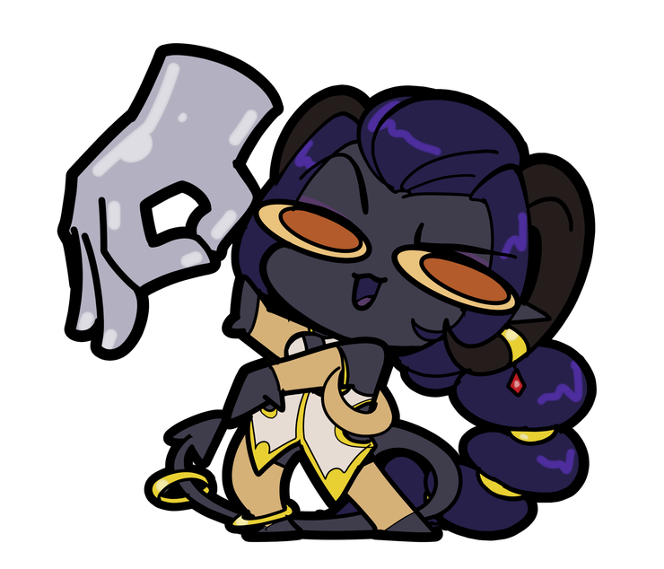
Anime Encourages Worldbuilding
We constantly ask:
“What is this world like?”
“How does the magic system work?”
“What’s the history of this setting?”
Anime Worldbuilding
Magic systems
Nations & factions
Lore mysteries
TTRPG Worldbuilding
Spell systems
Campaign settings
GM plot hooks

Slide 11
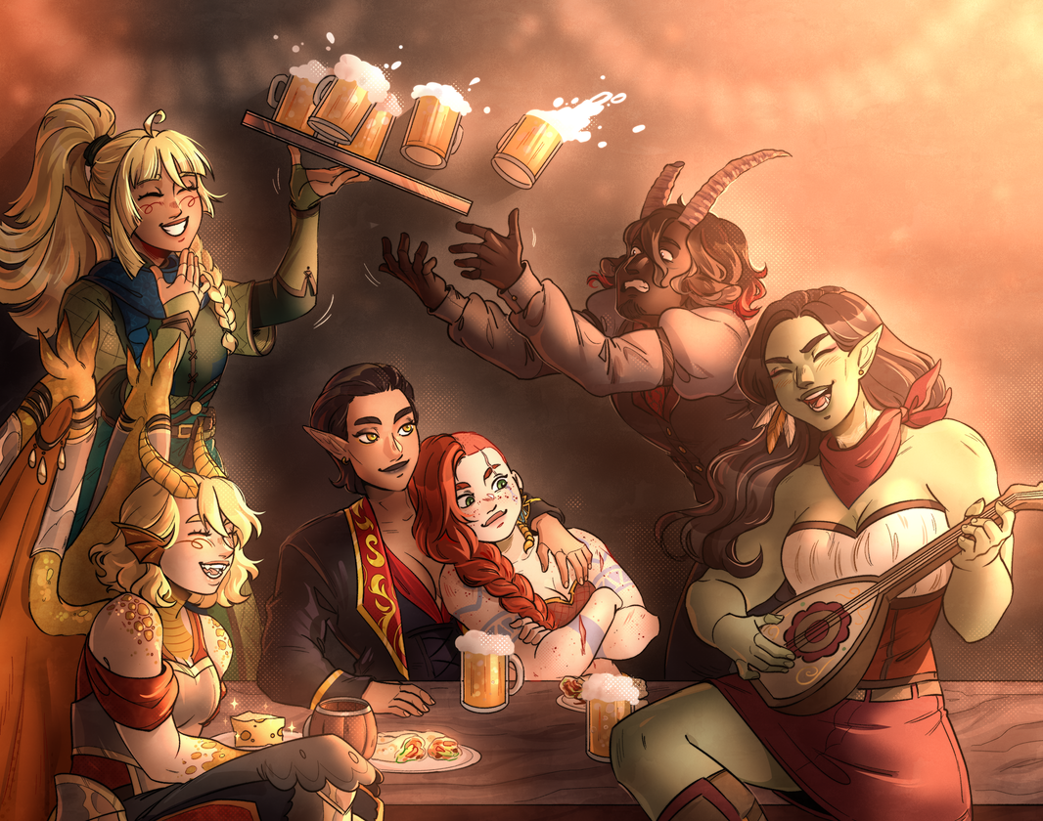
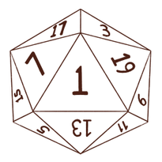
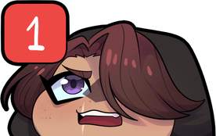
Anime Already Feels Like a Campaign
Many anime series literally follow RPG pacing.
Typical campaign arc structure:
Introduction to the world
Party forms
First mission
Rival appears
Major villain arc
Power growth
Climactic battle

Slide 12
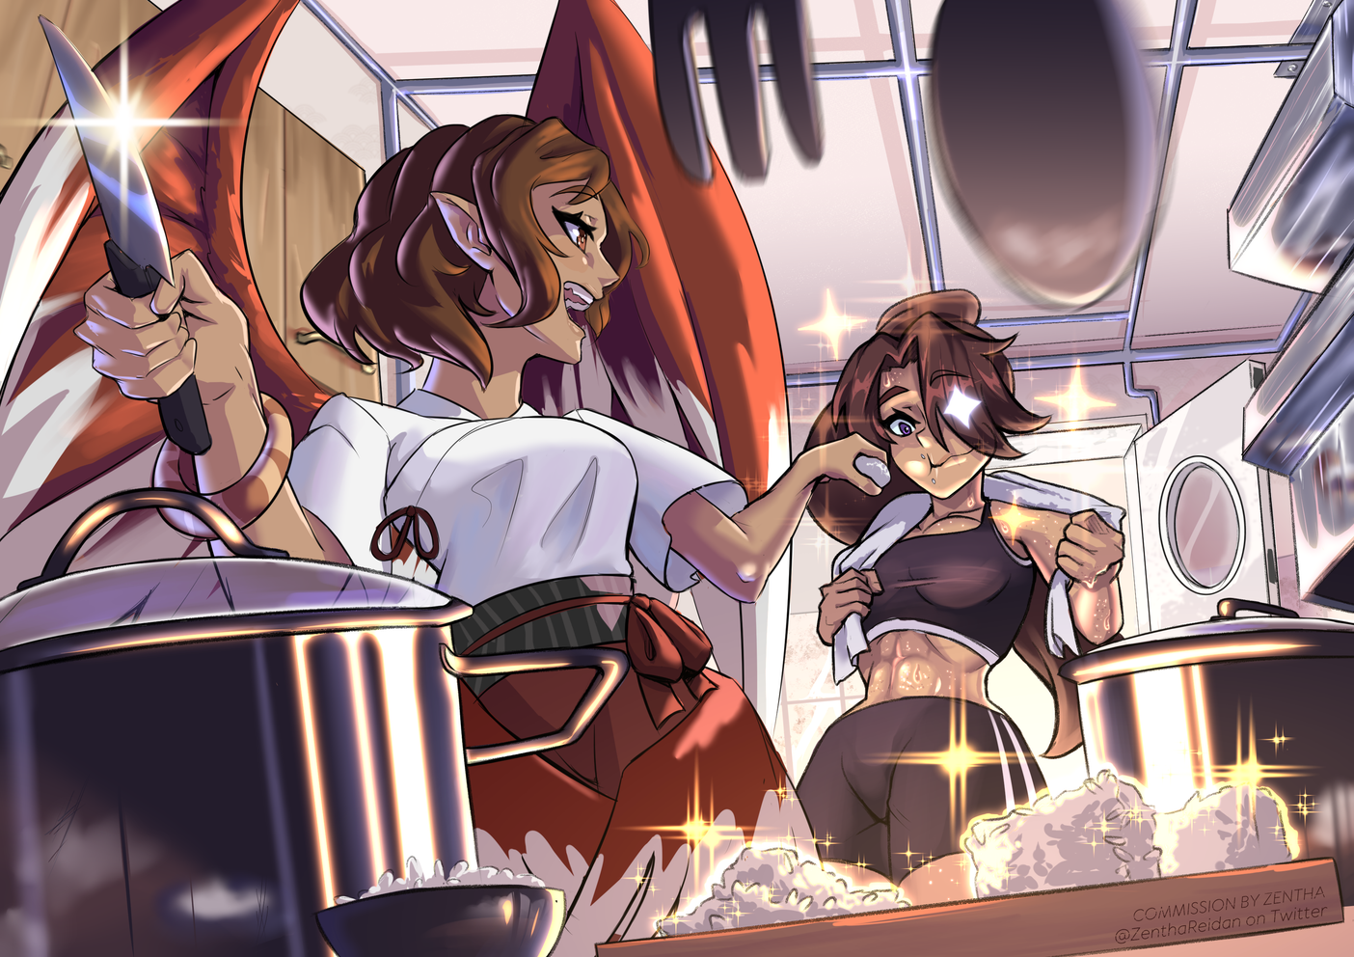
Anime Inspires Creative Output
Anime fandom encourages creation:
Fan art
Fan fiction
Cosplay
AMVs
Original characters (OCs)
TTRPGs fit into this ecosystem perfectly.
They allow us to:
create characters
tell stories
design worlds
collaborate with others

Slide 13
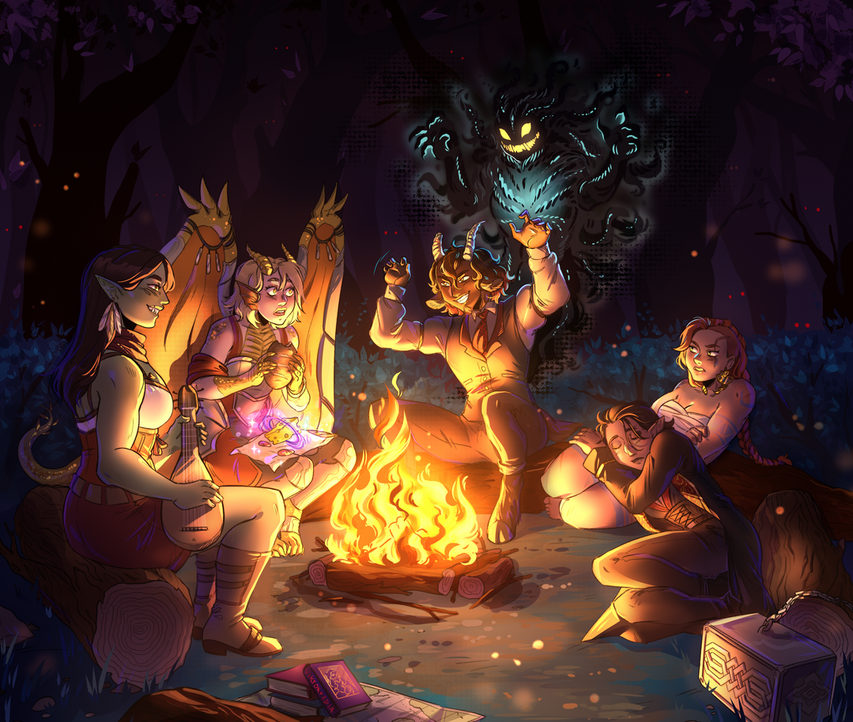
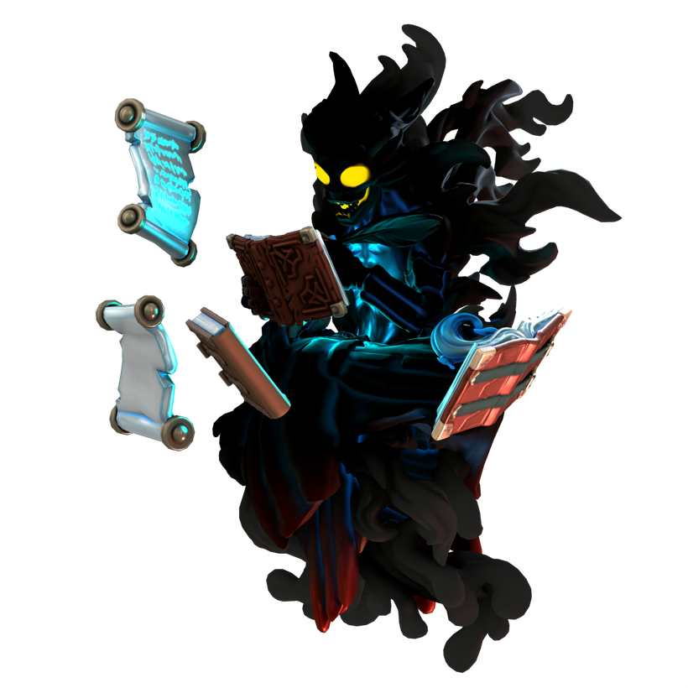
The Collaborative Storytelling Element
Anime storytelling is usually authored by a single creator, whereas TTRPGs involve shared storytelling.
Anime → Audience watches a story
TTRPG → Players become the story
That difference is powerful.
Anime asks, “What happens next?”
TTRPGs ask “What do you do next?”

Slide 14
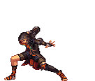
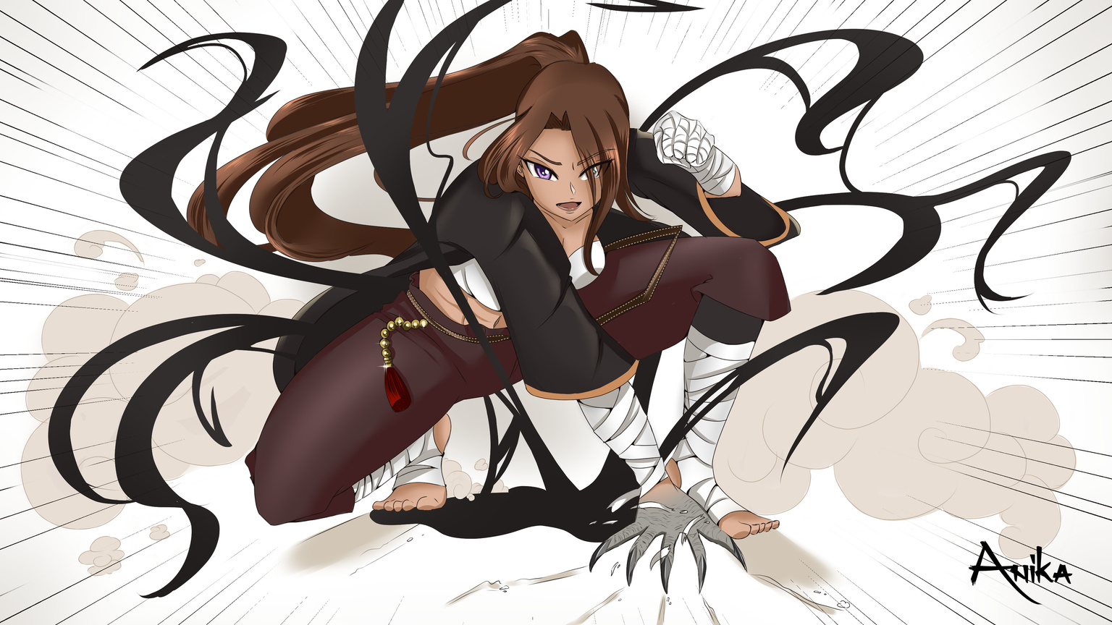
Anime Actually Influences TTRPG Design
The influence goes both ways.
Modern RPG design has absorbed anime storytelling ideas like:
cinematic combat
emotional character arcs
dramatic “power moments.”
friendship-driven narratives
Some games even lean directly into anime aesthetics.

Slide 15
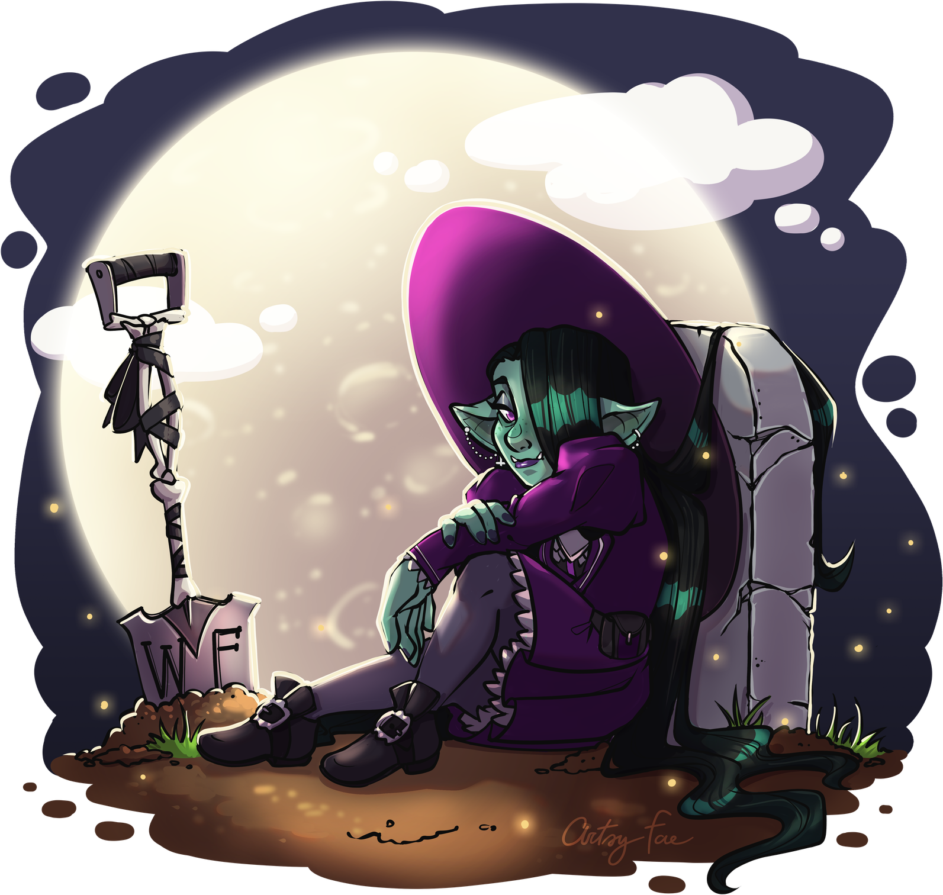
In Closing
Anime and TTRPGs share a core structure
a group of characters with unique abilities working together to overcome escalating challenges.
Anime emphasizes strong character identity
maps well to TTRPG character creation, including signature abilities, personal motivations, rivalries, relationships, and character growth over time.
Anime fandom already encourages creative engagement with fan art, cosplay, original characters, and last but not least, fan fiction
These all translate naturally into tabletop roleplaying.

Slide 16
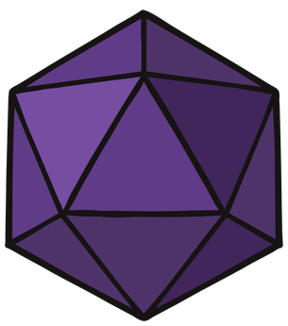
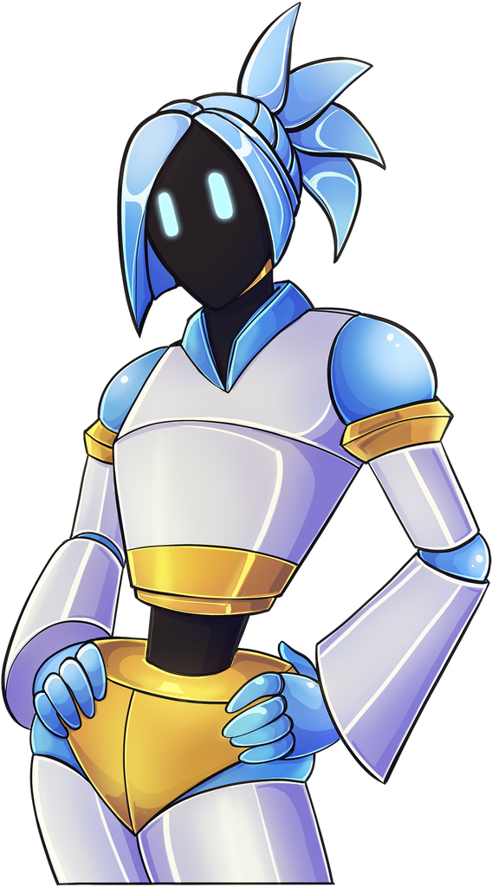
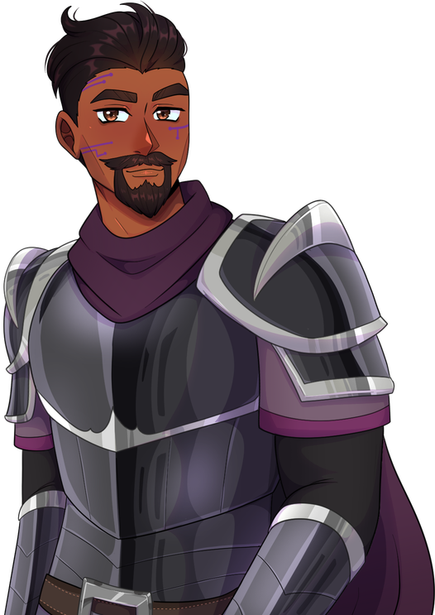
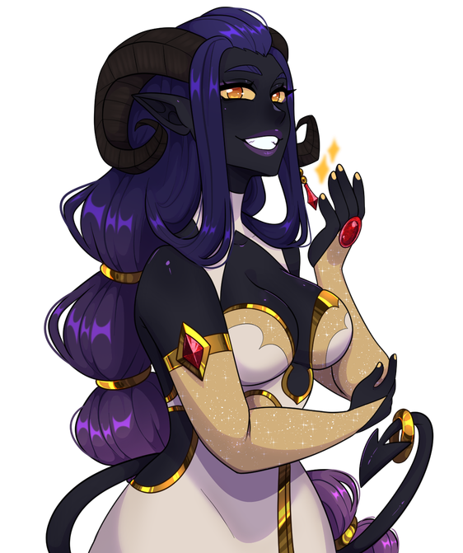
Special Thanks & Credits
Artsyfae
K0r1_robit
VioletWitchhh
Ruby_the_Lazy_Goblin
Melle_D
Zentha
Anika_crystalart
Xer0mega

Slide 17
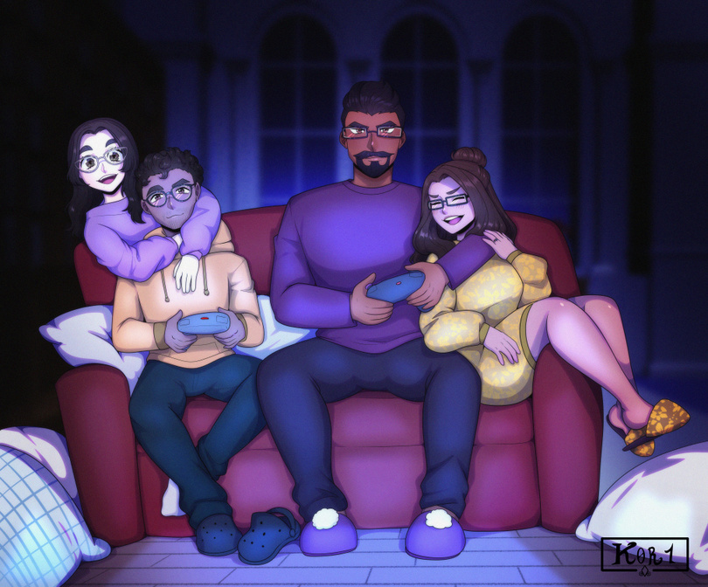
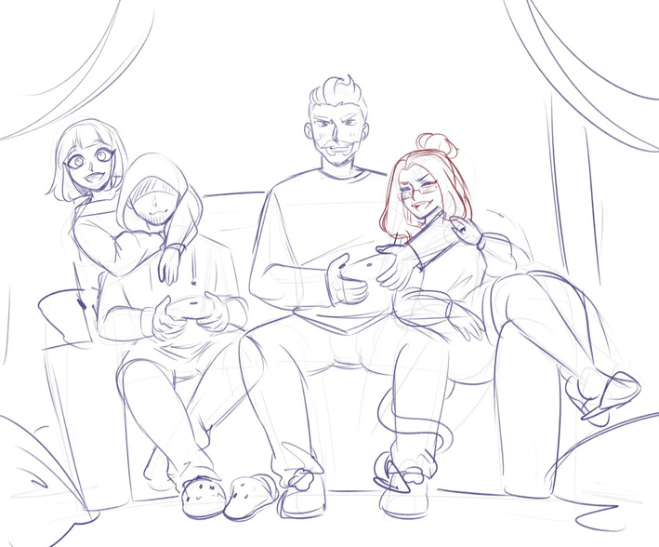
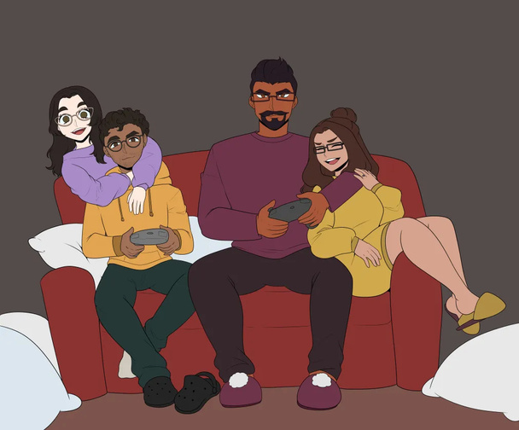
Time for examples
Lets go over some real time comparisons of
Anime and TTRPGs

Slide 18
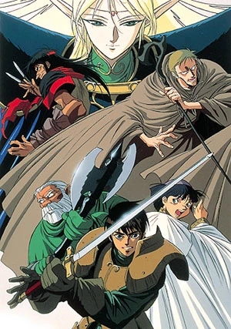
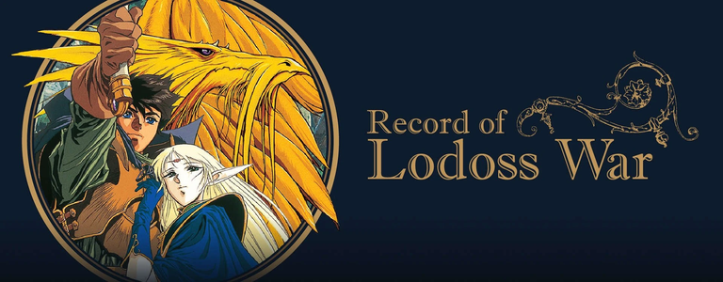
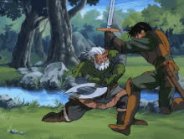

Classic Fantasy Anime
Anime: Record of Lodoss War
RPG Fit: Dungeons & Dragons
Record of Lodoss War began as a series of recorded tabletop sessions rather than a traditional novel.
Created and run by Ryo Mizuno
Published as “replay” transcripts in Comptiq magazine
These replays captured actual gameplay, including player choices and narrative outcomes
The campaign drew heavily from existing RPG systems and design:
Early editions of Dungeons & Dragons
The Japanese system Sword World RPG
From there, it expanded into novels, manga, and the 1990 anime adaptation, carrying over its campaign-like structure.

Slide 19
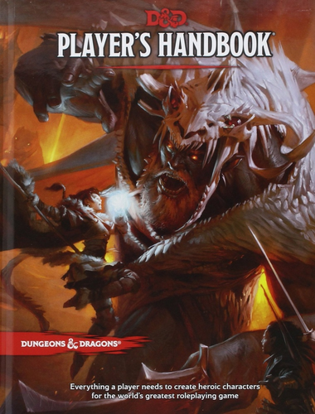
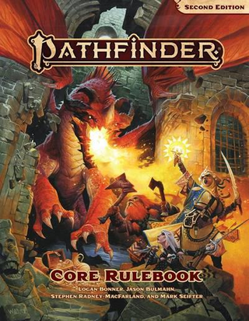
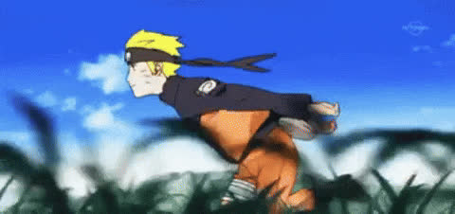
Action & Rivalries
Anime: Naruto
RPG Fit: Pathfinder Second Edition or Dungeons & Dragons Fifth Edition
Why it works:
tactical combat
unique character builds
signature abilities
rival characters
team missions
Anime
Ninja jutsu
Team missions
Power scaling
Clan techniques
RPG
Spells/Feats
Dungeons/Quests
Levels
Class Features

Slide 20
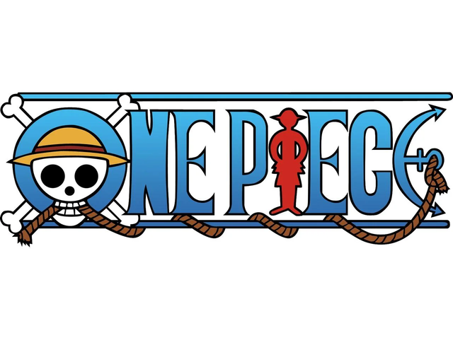
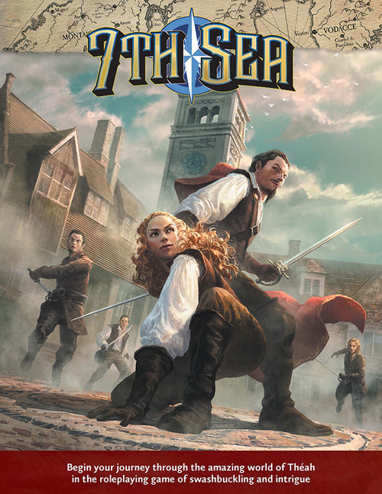
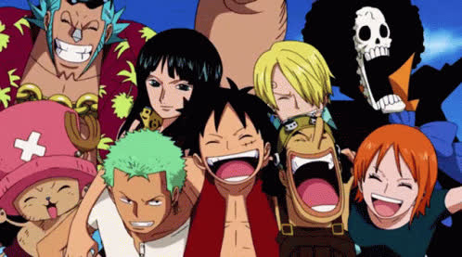
Found Family Adventure
Anime: One Piece
RPG Fit: 7th Sea or Fabula Ultima
Why it works:
swashbuckling adventures
crew dynamics
big personalities
episodic story arcs
dramatic villains

Slide 21
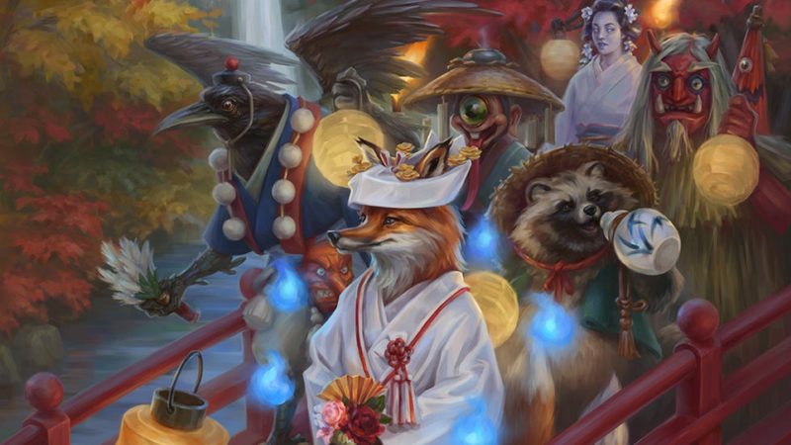
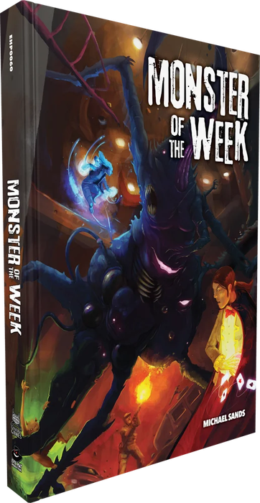

Monster Hunting
Anime: Demon Slayer: Kimetsu no Yaiba
RPG Fit: Monster of the Week or Pathfinder Second Edition
Why it works:
monster-focused missions
specialized techniques
emotional backstories
tragic villains

Slide 22




Epic War & Moral Dilemmas
Anime: Attack on Titan
RPG Fit: Band of Blades
Why it works:
desperate war against overwhelming threats
military hierarchy
character mortality
grim narrative tone

Slide 23



Magical Academia
Anime: My Hero Academia
RPG Fit: Masks: A New Generation
Why it works:
Young heroes learning their powers
emotional growth
identity struggles
hero mentorship

Slide 24




Alchemy, Mystery, and Politics
Anime: Fullmetal Alchemist: Brotherhood
RPG Fit: Blades in the Dark or Call of Cthulhu
Why it works:
investigation
conspiracies
moral consequences
powerful magic with rules

Slide 25





Anime Themed TTRPGs

Slide 26


